Slide 1
DDoS Attack Detection Using Federated Learning and Enhanced Neural Networks
Dogiparthi Harini – 22MIS1174
Pamala Thanmai – 22MIS1030

Slide 2
Introduction
A DDoS (Distributed Denial of Service) attacks gets down a server, network and websites with excessive traffic, causing disruption and downtime of the websites. It is crucial to detect the different types of DDoS attacks as they can cause severe damage to the services that are provided, lead to financial loss and threat to the cyber security. With the rise of technology, DDoS detection and prevention methodologies are essential to maintain system reliability and security. A growing number of Distributed Denial-of-Service (DDoS) attacks creates security risks for the networks which grow worse as these attacks become larger and more complex. Modern DDoS detection approaches using central data centers deal with multiple significant challenges because of their centralized data collection and processing architecture. Privacy risks emerge because sensitive information requires transmission to central servers despite scalability.
The solution of these problems requires finding innovative solutions which maintain privacy standards while detecting rapid DDoS attack. The decentralized learning approach called Federated Learning trains distributed edge devices to conduct model updates without data sharing. Devices under this approach perform model updates automatically before they transmit the computed data to a central server which ensures data privacy protection. FL has become widely adopted in different domains because it allows model training without exposing sensitive information.

Slide 3
Introduction
An Artificial Neural Network (ANN) is a computational model which got inspired by the human brain, consisting of many interconnected layers of neurons with deep architecture that process and learn from data. ANN is widely used for tasks like classification, regression, and pattern recognition due to its ability to capture complex relationships in data. It is preferred because of its adaptability, self-learning, and high accuracy in solving non-linear problems in various domains.
The suggested approach employs FL approach FedProx with enhanced Artificial Neural Networks as fundamental components to deploy a protective solution for networks against DDoS attacks. Multiple architectural changes were implemented to the ANN design for better model effectiveness together with improved robustness. The system integrates Lasso and Ridge regularization methods as regularization techniques to reduce overfitting and enhance model generalization for unseen data. The experimental process tests more advanced activation functions like ReLU, leaky Relu, Prelu to optimize learning to accelerate and stabilize the training of the network we have added batch normalization. The system combines architectural developments and FL to achieve distributed model update computation and managed information sharing thereby minimizing expenses and safeguarding personal data. DDoS attack detection can now have an efficient and scalable solution.

Slide 4
Problem statement
The increasing frequency of Distributed Denial-of-Service (DDoS) attacks pose significant challenges to network security, requiring effective and scalable detection methods. Traditional centralized machine learning approaches for DDoS detection suffer from privacy concerns, scalability limitations, and high communication overhead. These methods require large volumes of sensitive network traffic data to be transmitted to a central server, risking data leakage and creating significant bottlenecks in performance. Additionally, existing models often struggle to adapt to new and evolving attack patterns, leading to decreased effectiveness over time.
This project aims to address these challenges by proposing a Federated Learning-based system for DDoS attack detection, which allows decentralized model training across edge devices without compromising privacy. The system will leverage an Enhanced Artificial Neural Network (ANN) architecture with enhanced regularization techniques and advanced activation functions to improve generalization and robustness. By utilizing Federated Learning approach Fedprox, the proposed solution will enable real-time detection of DDoS attacks, ensuring scalability, privacy preservation, and adaptability to new attack patterns in large-scale networks.

Slide 5
Proposed System
The proposed architecture for DDoS detection using Federated Learning approach FedProx and enhanced Artificial Neural Networks (ANN) follows a structured approach to detect DDoS attack. The proposed model uses the CICDDoS2019 dataset, which contains various types of DDoS attacks and benign traffic data. The dataset undergoes data preprocessing, including data cleaning, data splitting, and feature extraction, to prepare it for training. Then the preprocessed data is used to classify network traffic into multiple DDoS attack types such as UDP, NetBIOS, UDPLag, LDAP, MSSQL, and SYN attacks. The ANN model is trained on the preprocessed data, with separate training and testing phases. To enhance the efficiency, Federated Learning approach FedProx is used, allowing multiple clients to train the ANN models independently. These local models update their weights, which are aggregated in the global ANN model in the server without sharing raw data. The final trained global model improves the detection of DDoS attacks while maintaining scalability.

Slide 6
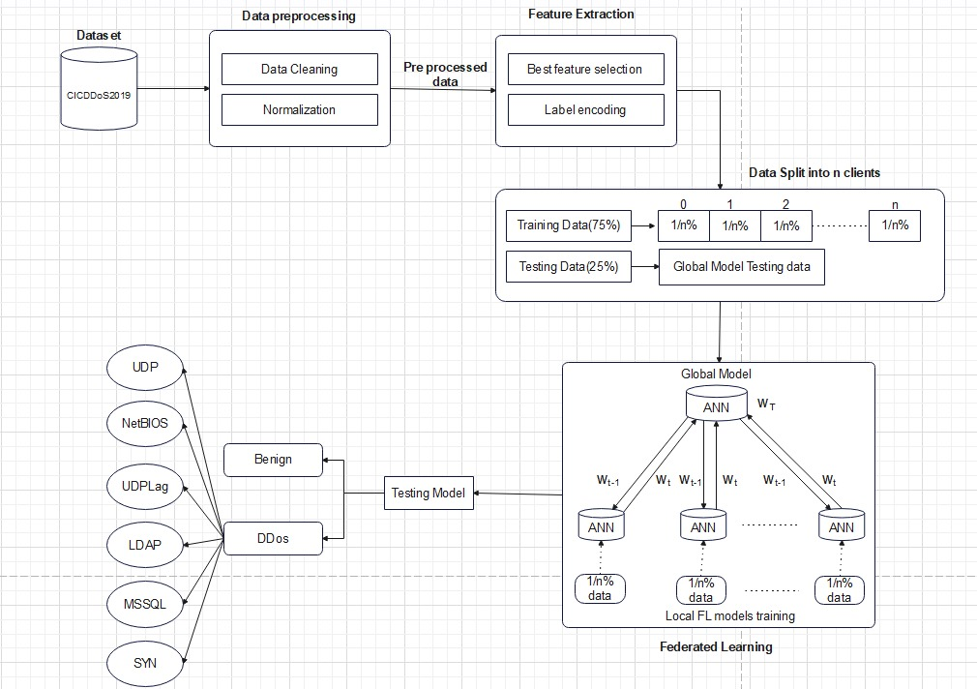
Proposed System architecture

Slide 7
Proposed System modules
Data Preprocessing Modules
Artificial Neural Network Architecture
Federated Model Framework
DDoS Detection Module

Slide 8
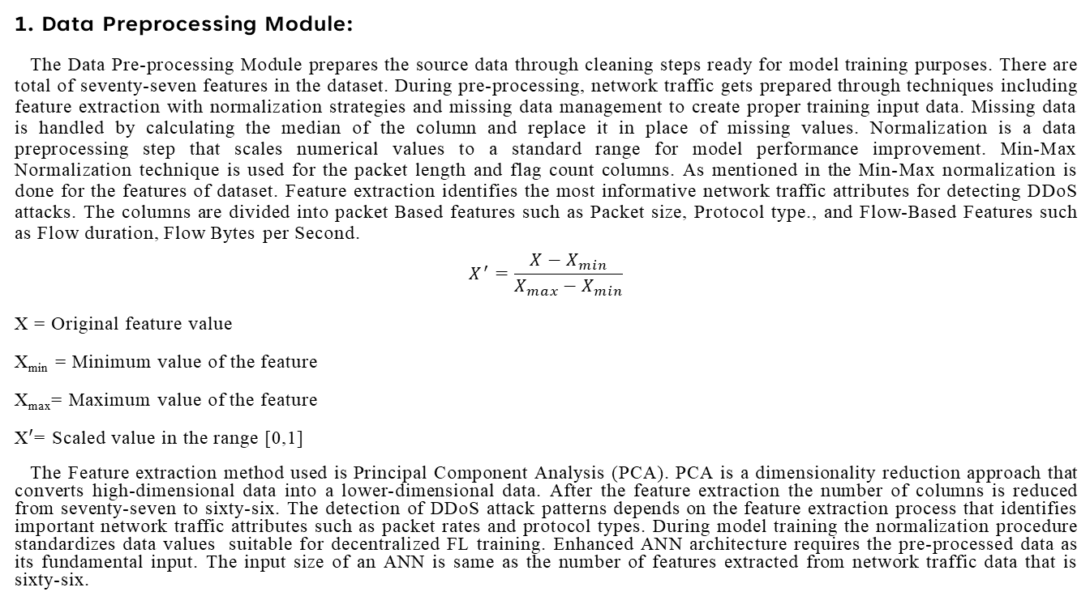
Proposed System Modules
1. Data Preprocessing Module:
The Data Pre-processing Module prepares the source data through cleaning steps ready for model training purposes. There are total of seventy-seven features in the dataset. During pre-processing, network traffic gets prepared through techniques including feature extraction with normalization strategies and missing data management to create proper training input data. Missing data is handled by calculating the median of the column and replace it in place of missing values. Normalization is a data preprocessing step that scales numerical values to a standard range for model performance improvement. Min-Max Normalization technique is used for the packet length and flag count columns. As mentioned in the Min-Max normalization is done for the features of dataset. Feature extraction identifies the most informative network traffic attributes for detecting DDoS attacks. The columns are divided into packet Based features such as Packet size, Protocol type., and Flow-Based Features such as Flow duration, Flow Bytes per Second.
$$X^{′}=\frac{X−X_{min}}{X_{max}−X_{min}}$$
X = Original feature value
X_{min} = Minimum value of the feature
X_{max}= Maximum value of the feature
X$′$= Scaled value in the range [0,1]
The Feature extraction method used is Principal Component Analysis (PCA). PCA is a dimensionality reduction approach that converts high-dimensional data into a lower-dimensional data. After the feature extraction the number of columns is reduced from seventy-seven to sixty-six. The detection of DDoS attack patterns depends on the feature extraction process that identifies important network traffic attributes such as packet rates and protocol types. During model training the normalization procedure standardizes data values suitable for decentralized FL training. Enhanced ANN architecture requires the pre-processed data as its fundamental input. The input size of an ANN is same as the number of features extracted from network traffic data that is sixty-six.

Slide 9
Proposed System Modules
2. Artificial Neural Network (ANN) Architecture:
The ANN architecture is divided into three subdivisions. They are input layer, hidden layers and output layer.
The enhanced layered architecture of ANN model for DDoS attacks detection which consists of multiple layers designed for effective learning. The input layer takes in traffic features that is 66 features. The first dense layer with ReLU activation function extracts the complex patterns from the input data. The dropout layer prevents the overfitting problem that is 30%. The second hidden layer with ReLU activation, followed by another Dropout layer (20%) for further regularization. This regularization techniques such as Lasso and Ridge prevents the overfitting problem of the ANN model. Lasso (also known as L1) and Ridge (also known as L2) regression are two popular regularization techniques that are used to avoid overfitting of data. These methods are used to penalize the coefficients to find the optimum solution and reduce complexity. The Lasso regression works by penalizing the sum of the absolute values of the coefficients. In Ridge or L2 regression, the penalty function is determined by the sum of the squares of the coefficients. Finally, the output layer applies Softmax activation, classifying network traffic into different DDoS attack types. And also declared the EarlyStopping that prevents overfitting. If the performance on the validation set starts to the loss increases or the accuracy decreases, it's an indication that the model is beginning to overfit the training data. At this point, early stopping is triggered, and the training process is halted.

Slide 10
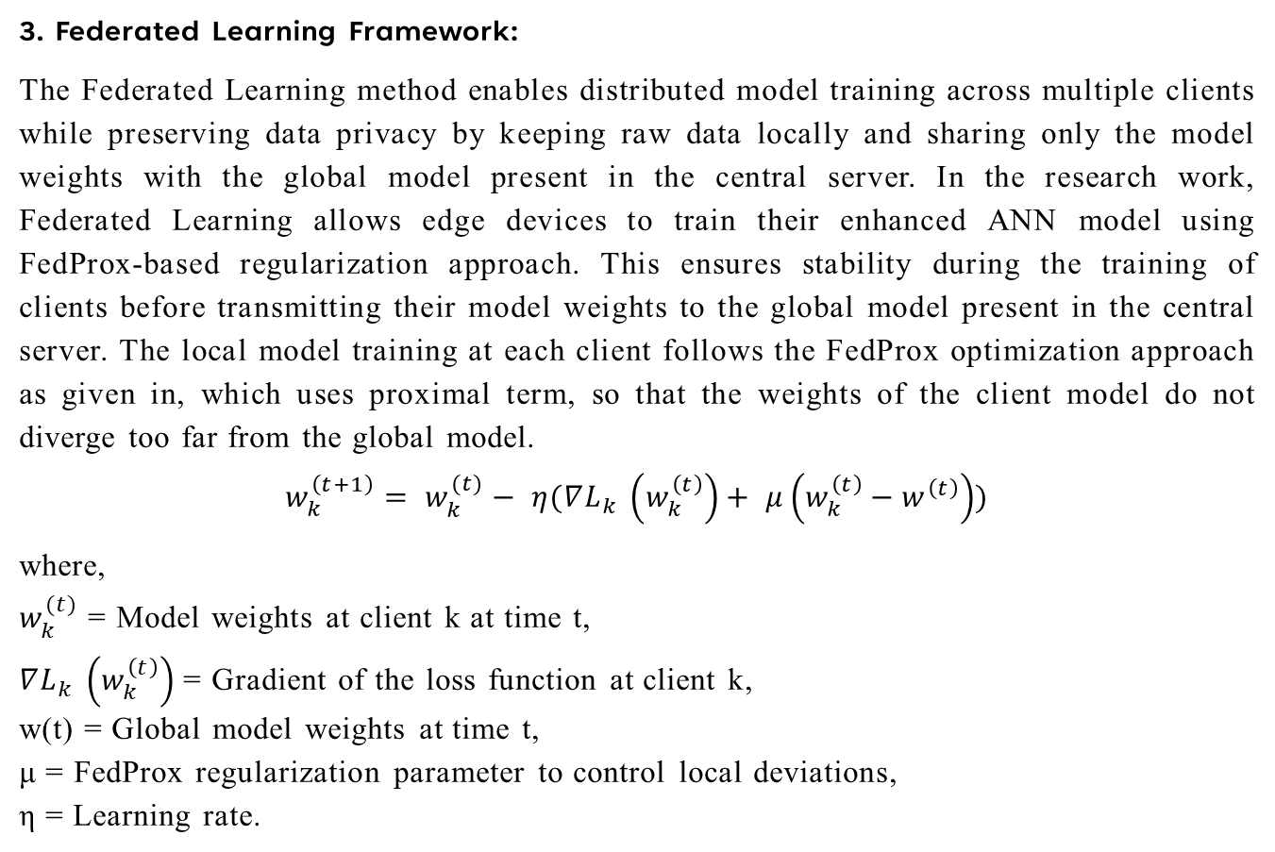
Proposed System Modules
3. Federated Learning Framework:
The Federated Learning method enables distributed model training across multiple clients while preserving data privacy by keeping raw data locally and sharing only the model weights with the global model present in the central server. In the research work, Federated Learning allows edge devices to train their enhanced ANN model using FedProx-based regularization approach. This ensures stability during the training of clients before transmitting their model weights to the global model present in the central server. The local model training at each client follows the FedProx optimization approach as given in, which uses proximal term, so that the weights of the client model do not diverge too far from the global model.
$$w_{k}^{\left(t+1\right)}= w_{k}^{(t)}− η(∇L_{k }\left(w_{k}^{\left(t\right)}\right)+ μ\left(w_{k}^{\left(t\right)}−w^{\left(t\right)}\right))$$
where,
$w_{k}^{(t)}$​ = Model weights at client k at time t,
$∇L_{k }\left(w_{k}^{\left(t\right)}\right)$ = Gradient of the loss function at client k,
w(t) = Global model weights at time t,
μ = FedProx regularization parameter to control local deviations,
η = Learning rate.

Slide 11
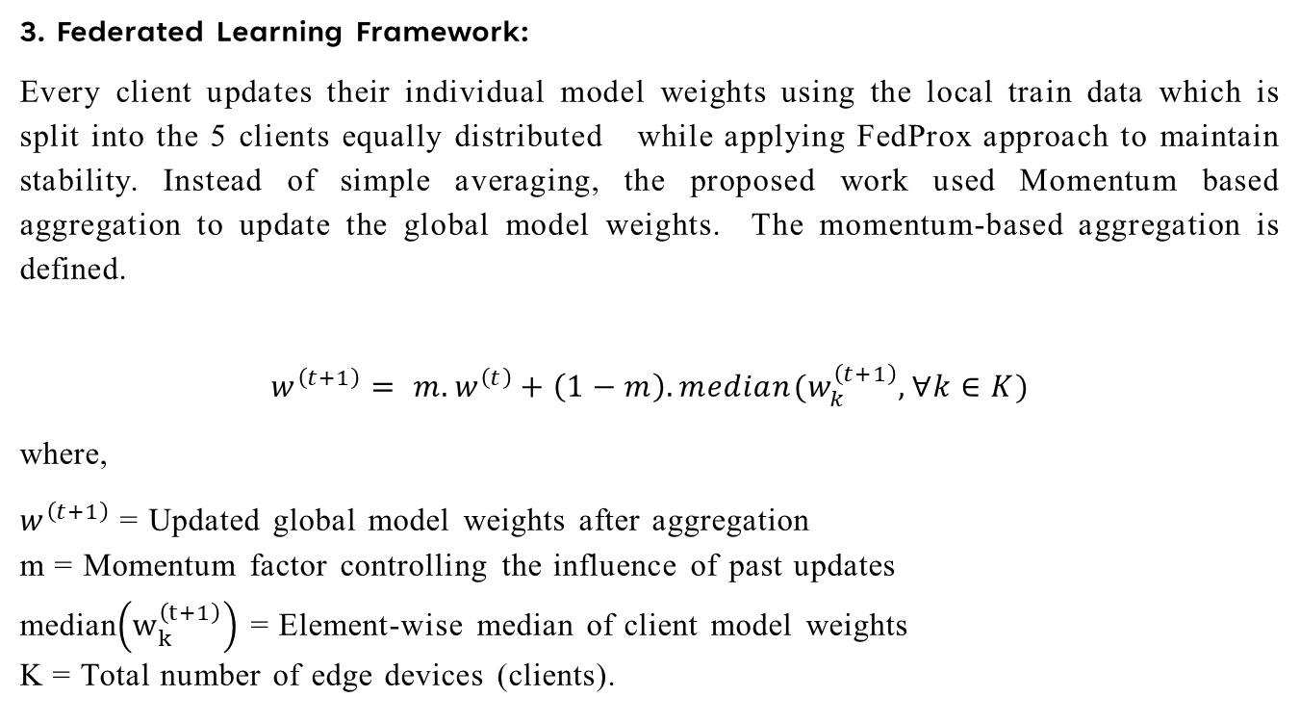
Proposed System Modules
3. Federated Learning Framework:
Every client updates their individual model weights using the local train data which is split into the 5 clients equally distributed while applying FedProx approach to maintain stability. Instead of simple averaging, the proposed work used Momentum based aggregation to update the global model weights. The momentum-based aggregation is defined.
$$w^{\left(t+1\right)}= m.w^{\left(t\right)}+\left(1−m\right). median(w_{k}^{\left(t+1\right)}, ∀k∈K)$$
where,
$w^{\left(t+1\right)}$ = Updated global model weights after aggregation
m = Momentum factor controlling the influence of past updates
median$\left(w_{k}^{\left(t+1\right)}\right)$ = Element-wise median of client model weights
K = Total number of edge devices (clients).

Slide 12
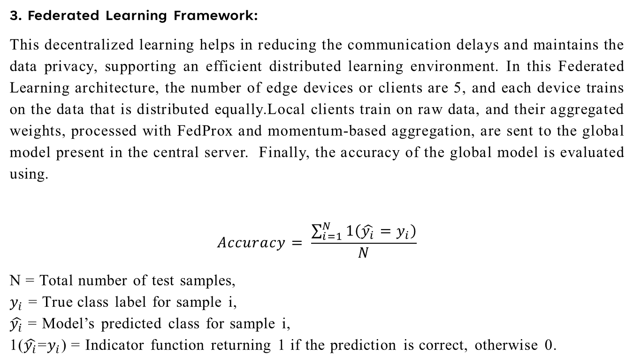
Proposed System Modules
3. Federated Learning Framework:
This decentralized learning helps in reducing the communication delays and maintains the data privacy, supporting an efficient distributed learning environment. In this Federated Learning architecture, the number of edge devices or clients are 5, and each device trains on the data that is distributed equally.Local clients train on raw data, and their aggregated weights, processed with FedProx and momentum-based aggregation, are sent to the global model present in the central server. Finally, the accuracy of the global model is evaluated using.
$$Accuracy= \frac{\sum_{i=1}^{N}{1\left(\hat{y_{i}}=y_{i}\right)}}{N}$$
N = Total number of test samples,
$y_{i}$​ = True class label for sample i,
$\hat{y_{i}}$ = Model’s predicted class for sample i,
1($\hat{y_{i}}$=$y_{i}$) = Indicator function returning 1 if the prediction is correct, otherwise 0.

Slide 13
Proposed System Modules
4. DDoS Detection Module:
The DDoS Detection Module runs the traffic monitoring to find signatures which point toward DDoS attacks. The system detects several attack types through its mechanism with a focus on processing SYN, UDP, LDAP, MSSQL, NetBIOS, UDPLag communications. Using the Federated Learning-trained ANN model with regularized backpropagation and ReLU activation functions the module obtains high accuracy for recognizing normal from malicious traffic. This module handles efficient detection of attacks through dynamic environments by using optimizers including Adam for weight management selection. This module functions in real time while being decentralized which enables it to scale according to current threats.

Slide 14
Results
The proposed work follows decentralized training across 5 edge devices and data is split into one-fifth of data equally for each client accordingly, preserving data privacy and enhancing model performance. Unlike the traditional ANN, which suffers from limited scalability and overfitting, the proposed research work, Federated Learning algorithm FedProx for DDoS Detection System ensures scalability through multiple mechanisms. A decentralized approach is used instead of processing all the data by one model and model training is distributed across multiple edge devices, reducing the load on a single server. Adaptive Federated Learning with FedProx and Momentum Aggregation overcome scalability issues by reducing communication overhead. In Federated Learning, continuous communication between the clients and the server can cause the network congestion as the number of clients gets increasing. By using FedProx approach local model weights do not deviate too far from the global model weights. This results us fewer Federated Learning rounds, reducing the excessive data transmission. Then, a momentum-based weight aggregation is deployed. In the global model, weight is updated using FedProx, without requiring direct access to raw data. As a result, the Enhanced ANN with Federated Learning achieves superior performance of 99% compared to the conventional ANN model of 72%, making it a more reliable, scalable, and effective solution for DDoS detection.

Slide 15
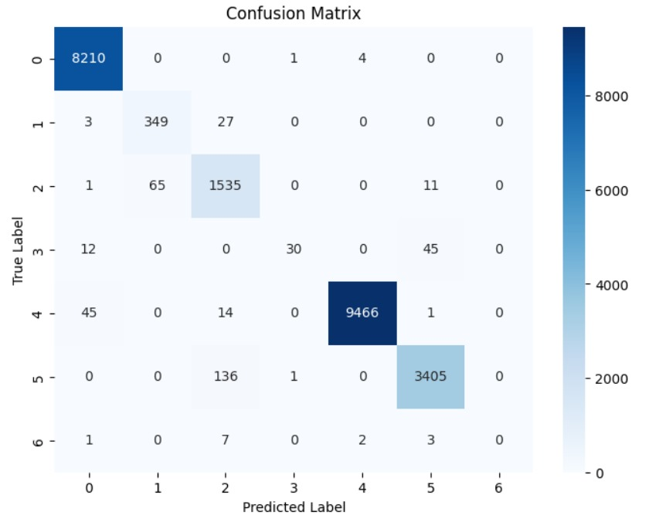
Results
The above is the confusion matrix for Enhanced ANN with federative Learning.

Slide 16
results
Attacks | Precision | Recall | F1-Score
Benign | 99% | 100% | 100%
LDAP | 84% | 92% | 88%
MSSQL | 89% | 95% | 92%
NetBIOS | 94% | 34% | 50%
Syn | 100% | 99% | 100%
UDP | 98% | 96% | 97%
The above table provides the classification report the different types of attacks individually. The classification report contains precision, recall and F1-score for evaluation of ANN model.

Slide 17
results
Round | Client 1 | Client 2 | Client 3 | Client 4 | Client 5
Round-1 | 63.33% | 62.71% | 62.92% | 63.07% | 63.91%
Round-5 | 98.02% | 98.04% | 97.59% | 97.67% | 97.60%
Round-10 | 97.96% | 98.07% | 98.06% | 98.32% | 98.16%
Round-15 | 98.38% | 97.92% | 98.33% | 97.91% | 98.21%
Round-20 | 98.47% | 98.05% | 98.17% | 98.04% | 98.33%
Round-25 | 98.63% | 98.37% | 98.21% | 98.50% | 98.34%
The above table provides the accuracy of each client for every federated learning round. The accuracy for the each client increases for every round with the increase in learning rate.

Slide 18
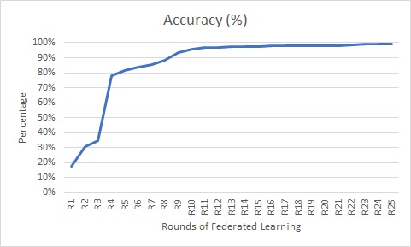
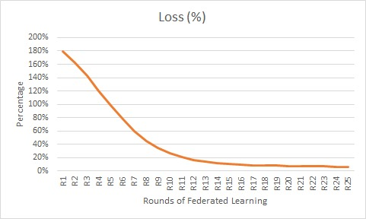
results
The above two graphs are accuracy and loss for the model after every round of federated Learning.

Slide 19
Conclusion and Future Work
The proposed Federated Learning approach FedProx with enhanced Artificial Neural Networks (ANNs) based DDoS detection system achieve high accuracy while maintaining data privacy. The Data Preprocessing Module provides best and quality input to the model by handling missing values, normalization of data and extracting the features of network traffic, improving model performance across many client devices. The ANN Architecture, optimized with ReLU, leaky Relu and Prelu activation functions, along with Lasso and Ridge regularization, prevents overfitting and improves model performance. The optimizers which are used like Adam improves the learning efficiency and learns the typical features that are extracted, leading to a detection accuracy of 99%. By incorporating Federated Learning i.e FedProx Framework, the system enables data privacy and decentralized model training, where the sensitive data regarding the network traffic remains on local devices that means client models while only weights of the models are updated by momentum aggregation all the weights between the nodes or neurons. The DDoS Detection Module effectively identifies multiple attack types, including Syn, UDP, LDAP, NetBIOS, MSSQL, and UDPLag achieving high precision, recall and F1-score of 94%, 86% and 88% respectively. The model demonstrates the monitoring capabilities and detecting different types of attack patterns with minimum false positives. Overall, this Federated Learning -driven DDoS detection system achieves 99% accuracy enhances cybersecurity resilience. Future work can focus on optimizing model efficiency for large-scale deployment and improving detection of not represented attack types.

Slide 20
References
https://cybersecurityventures.com/the-15-top-ddos-statistics-you-should-know-in-2020
https://www.comparitech.com/blog/information-security/ddos-statistics-facts
https://qrator.net/blog/details/2023-ddos-attacks-statistics-and-observations
https://www.linkedin.com/pulse/artificial-neural-network-model-classification-regression-doug-rose-ucihe
Bhatia, K., Bhattacharya, S., & Sharma, I. (2024, February). Privacy-Preserving Detection of DDoS Attacks in IoT Using Federated Learning Techniques. In 2024 IEEE International Conference on Big Data & Machine Learning (ICBDML) (pp. 234-239). IEEE.
Maiga, A. A., Ataro, E., & Githinji, S. (2024, June). XGBoost and Deep Learning Based-Federated Learning for DDoS Attack Detection in 5G Core Network VNFs. In 2024 6th International Conference on Computer Communication and the Internet (ICCCI) (pp. 128-133). IEEE.
Doriguzzi-Corin, R., & Siracusa, D. (2024). FLAD: adaptive Federated Learning for DDoS attack detection. Computers & Security, 137, 103597.

Slide 21
References
Saveetha, D., Maragatham, G., Ponnusamy, V., & Zdravković, N. (2024). An integrated federated machine learning and blockchain framework with optimal miner selection for reliable ddos attack detection. IEEE Access.
Mahadik, S. S., Pawar, P. M., & Muthalagu, R. (2024). Edge-Federated Learning based Intelligent Intrusion Detection System for Heterogeneous Internet of things. IEEE Access.
Li, K., Zhou, H., Tu, Z., Wang, W., & Zhang, H. (2020). Distributed network intrusion detection system in satellite-terrestrial integrated networks using federated learning. IEEE Access, 8, 214852-214865.
Ferrag, M. A., Friha, O., Hamouda, D., Maglaras, L., & Janicke, H. (2022). Edge-IIoTset: A new comprehensive realistic cyber security dataset of IoT and IIoT applications for centralized and federated learning. IEEe Access, 10, 40281-40306.
Nguyen, T. G., Phan, T. V., Hoang, D. T., Nguyen, T. N., & So-In, C. (2021). Federated deep reinforcement learning for traffic monitoring in SDN-based IoT networks. IEEE Transactions on Cognitive Communications and Networking, 7(4), 1048-1065.
Li, J., Lyu, L., Liu, X., Zhang, X., & Lyu, X. (2021). FLEAM: A federated learning empowered architecture to mitigate DDoS in industrial IoT. IEEE Transactions on Industrial Informatics, 18(6), 4059-4068.

Slide 22
References
Liu, Z., & Yin, X. (2021). LSTM-CGAN: Towards generating low-rate DDoS adversarial samples for blockchain-based wireless network detection models. IEEE Access, 9, 22616-22625.
Alhasawi, Y., & Alghamdi, S. (2024). Federated Learning for Decentralized DDoS Attack Detection in IoT Networks. IEEE Access, 12, 42357-42368.
Pourahmadi, V., Alameddine, H. A., Salahuddin, M. A., & Boutaba, R. (2022). Spotting anomalies at the edge: Outlier exposure-based cross-silo Federated Learning for ddos detection. IEEE Transactions on Dependable and Secure Computing, 20(5), 4002-4015.
Zhang, J., Yu, P., Qi, L., Liu, S., Zhang, H., & Zhang, J. (2021, October). FLDDoS: DDoS attack detection model based on Federated Learning. In 2021 IEEE 20th International Conference on Trust, Security and Privacy in Computing and Communications (TrustCom) (pp. 635-642). IEEE.
Kautish, S., Reyana, A., & Vidyarthi, A. (2022). SDMTA: Attack detection and mitigation mechanism for DDoS vulnerabilities in hybrid cloud environment. IEEE Transactions on Industrial Informatics, 18(9), 6455-6463.
Dao, N. N., Phan, T. V., Sa’ad, U., Kim, J., Bauschert, T., Do, D. T., & Cho, S. (2021). Securing heterogeneous IoT with intelligent DDoS attack behavior learning. IEEE Systems Journal, 16(2), 1974-1983.
N. (2024). Strengthening network DDOS attack detection in heterogeneous IoT environment with federated XAI learning approach. Scientific Reports, 14(1), 24322.

Slide 23
THANK YOU

